Slide 1

Line Coding Techniques
Associate Professor
Department of Computer Science and Engineering

Slide 2
Session Objectives
After going through this session you will be able to understand:
Digital data and digital signal representation
Technique for Line Coding

Slide 3
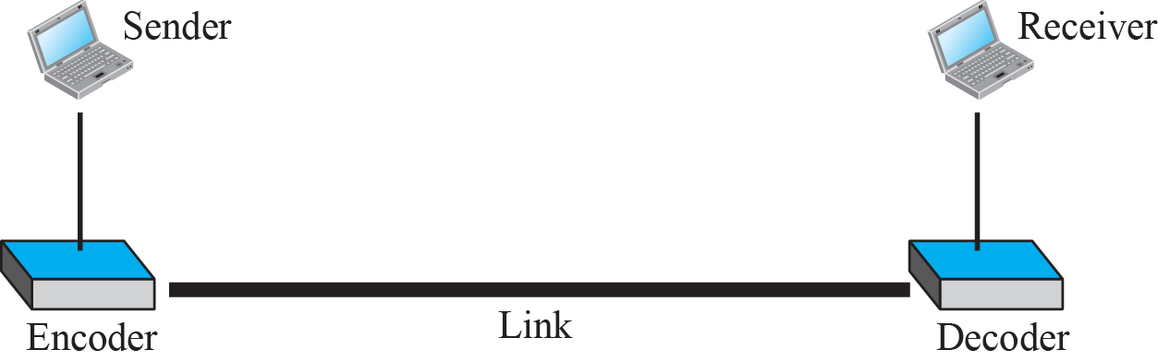
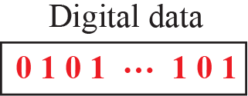
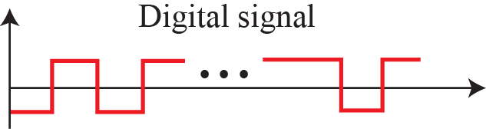
Line Coding
Line coding is the process of converting digital data to digital signals.
It is assumed that data, in the form of text, numbers, graphical images, audio, or video, are stored in computer memory as sequences of bits.
Line coding converts a sequence of bits to a digital signal. At the sender, digital data are encoded into a digital signal; at the receiver, the digital data are recreated by decoding the digital signal.

Slide 4
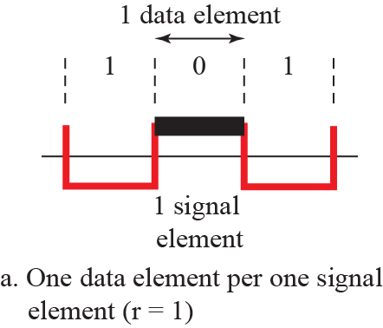
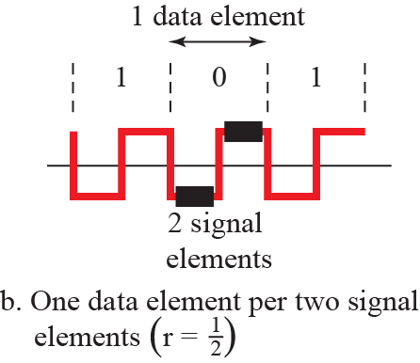
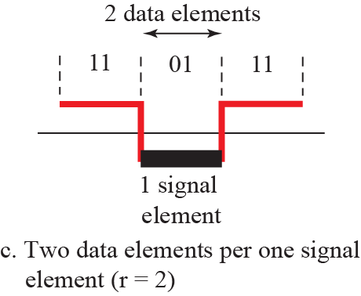
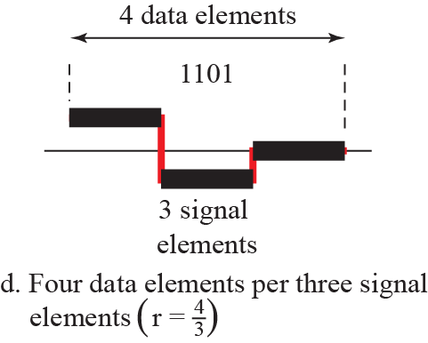
Digital signal representation

Slide 5
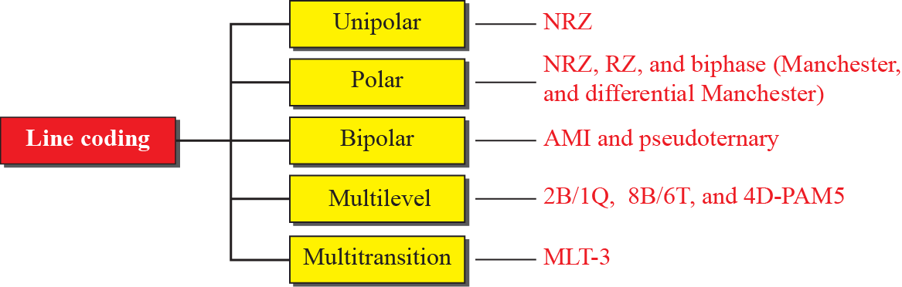
Line Coding Schemes
Polarity
The separation, alignment or orientation of something into two opposed poles.
We can roughly divide line coding schemes into five broad categories, as shown below
NRZ: Non return to zero
NRZ-I: non return to zero inverted
AMI: Alternate Mark Inversion
2B1Q: Two-binary, one-quaternary
4D-PAM5: 4-data line, 5-level pulse amplitude modulation
MLT-3: Multi-Level Transmit
Notes:
Unipolar scheme –In this scheme, all the signal levels are either above or below the axis.
Polar schemes –In polar schemes, the voltages are on the both sides of the axis.
Bipolar schemes –In this scheme there are three voltage levels positive, negative, and zero.
Multilevel/Multitransition -is a line code (a signaling method used in a telecommunication system for transmission purposes) that uses three voltage levels.
4.#

Slide 6
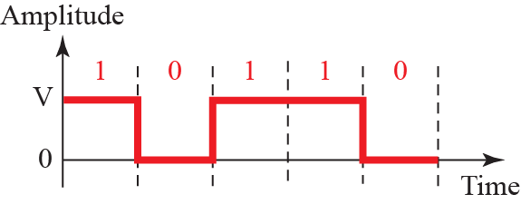
Unipolar NRZ Coding
Unipolar encoding only makes use of one polarity, i.e. positive voltage, to represent a binary 1 and it uses an idle line to represent a binary 0, i.e. zero voltage.

Slide 7
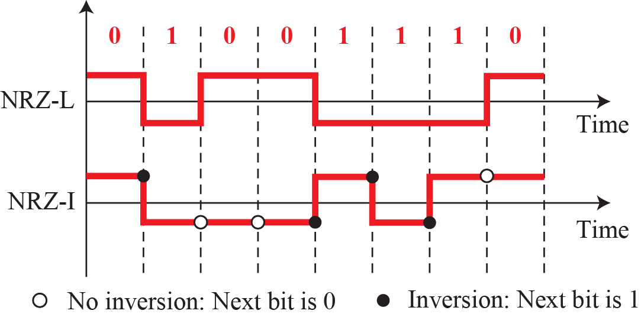
Polar NRZ-L and NRZ-I Coding
Polar schemes
In polar schemes, the voltages are on the both sides of the axis. Examples NRZ-L, NRZ-I

Slide 8
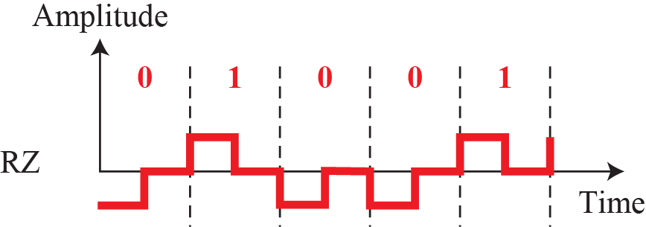
Polar RZ Coding
Notes:
4.#

Slide 9
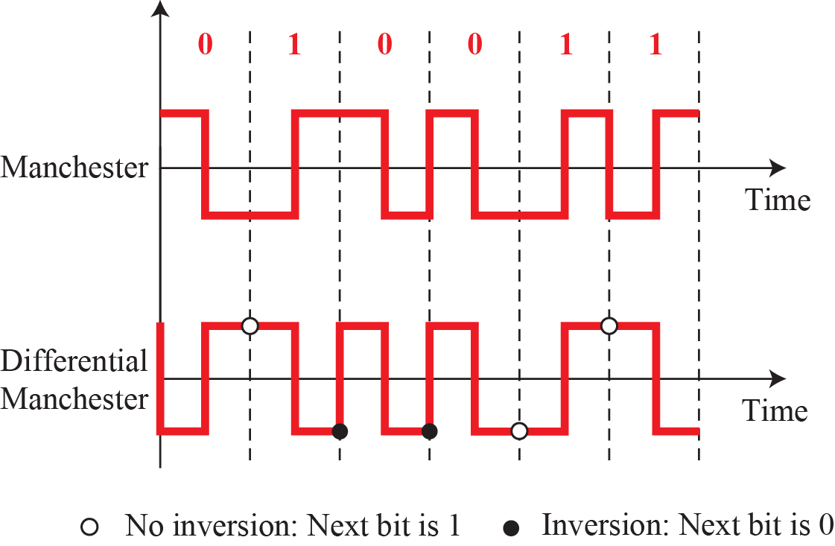
Polar Manchester and Differential Manchester Coding
Notes:
4.#

Slide 10
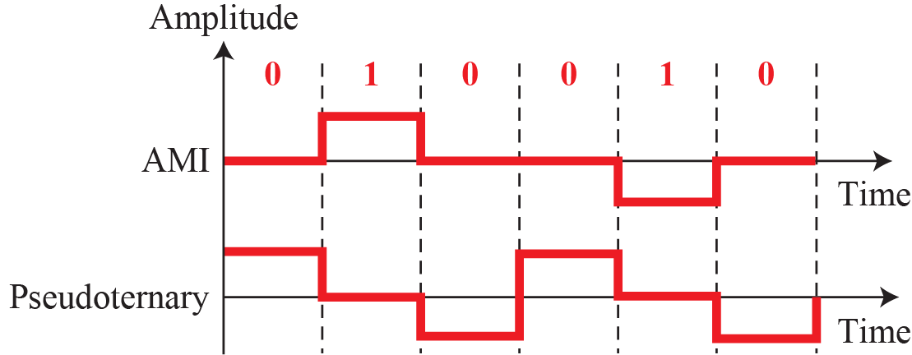
Bi-Polar AMI and Pseudoternary Coding
Bipolar schemes
In this scheme there are three voltage levels positive, negative, and zero. The voltage level for one data element is at zero, while the voltage level for the other element alternates between positive and negative.
Notes:
AMI – Amplitude Mark Inversion
4.#

Slide 11
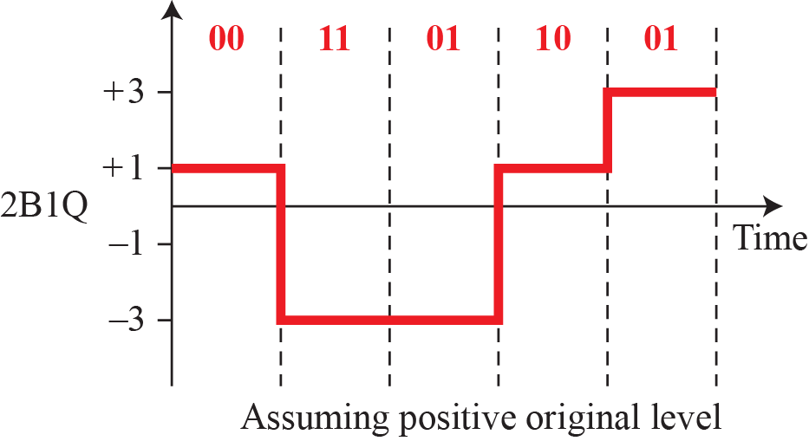
Multlevel 2B1Q
 | previous Level: Positive | Previous Level: Negative
Next Bit | Next Level | Next Level
00 | +1 | -1
01 | +3 | -3
10 | -1 | +1
11 | -3 | +3
Notes:
4.#

Slide 12
Activity
For the give data pattern
1011001011000111
1111000010110101
Apply the following Algorithms
NRZ, NRZ-I, NRZ – L
RZ
Manchester and Differential Manchester
AMI
Pseudoternary
2B1Q
Notes:
1.#

Slide 13
Summary
In this section we have discussed the following:
Line Coding Techniques
Polar and bi-polar technique for coding
Notes:
1.#

Slide 14

Notes:
1.#

